Slide 1
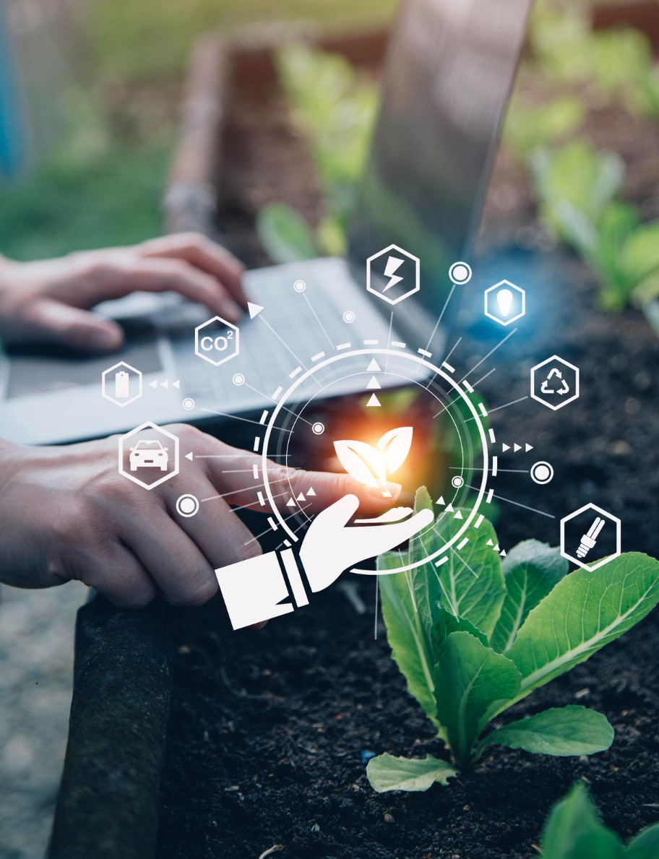
IoT In Agriculture

Slide 2

Introduction
IoT in agriculture integrates sensors and technology to optimize farming practices, enhance crop yield, improve resource management, and ensure sustainability.

Slide 3
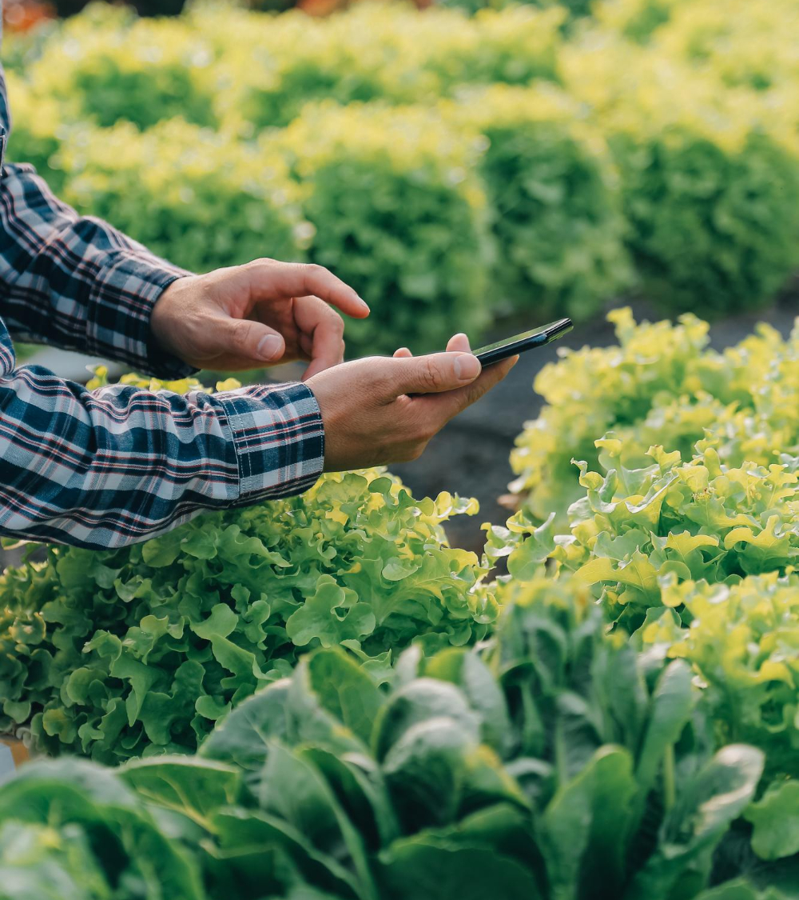
Precision Farming
Precision farming uses IoT technology to monitor crop conditions meticulously, optimizing inputs like water and fertilizer
for enhanced productivity and sustainability.

Slide 4


Smart Sensors
These tools are the backbone of modern precision agriculture, enabling farmers to collect and analyze data in real time. Key IoT devices in agriculture include:
Soil Moisture Sensors
Weather Stations
Drones and Aerial Imagery Sensors
Livestock Trackers
Nutrient Sensors

Slide 5
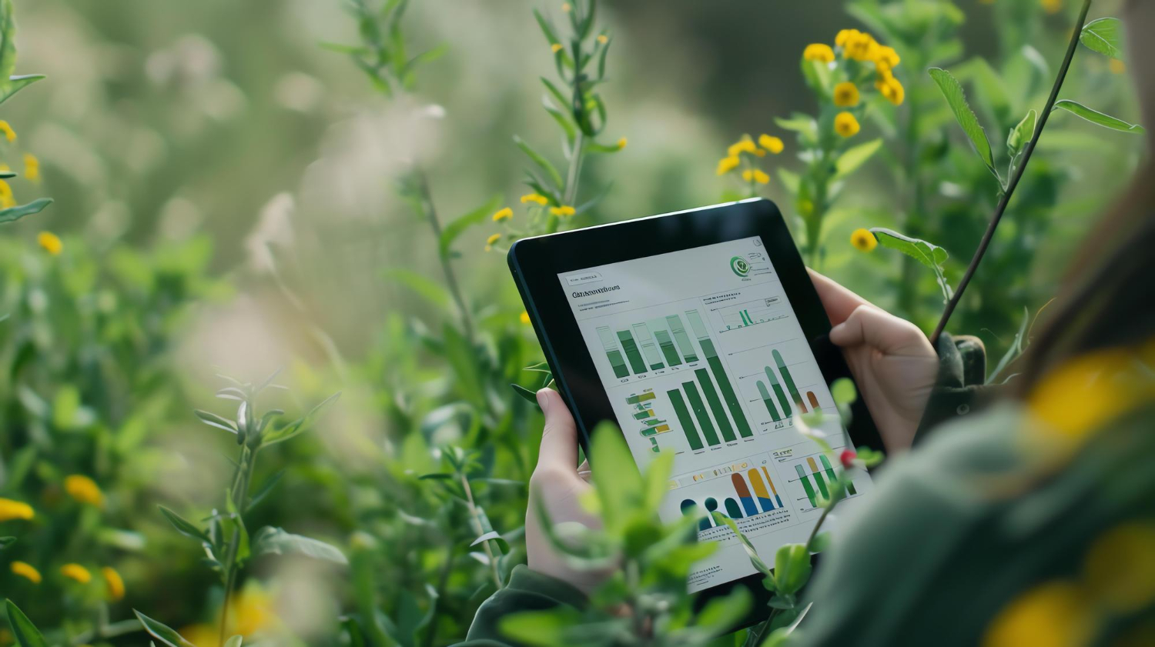





Data Analytics In Agriculture
Data analytics in agriculture uses IoT data to enhance decision-making, optimize resources, and improve crop yields by analyzing soil, weather, and crop health trends.
Predictive Analytics
Forecasts conditions, anticipating challenges like pests and weather.
Prescriptive Analytics
Provides actionable insights for optimal planting and fertilization.
Spatial Analysis
Analyzes location data for targeted farming interventions.
Yield Prediction
Uses data to predict yields, improving marketing decisions.
Resource Optimization
Enhances water, soil, and energy use, increasing efficiency.

Slide 6
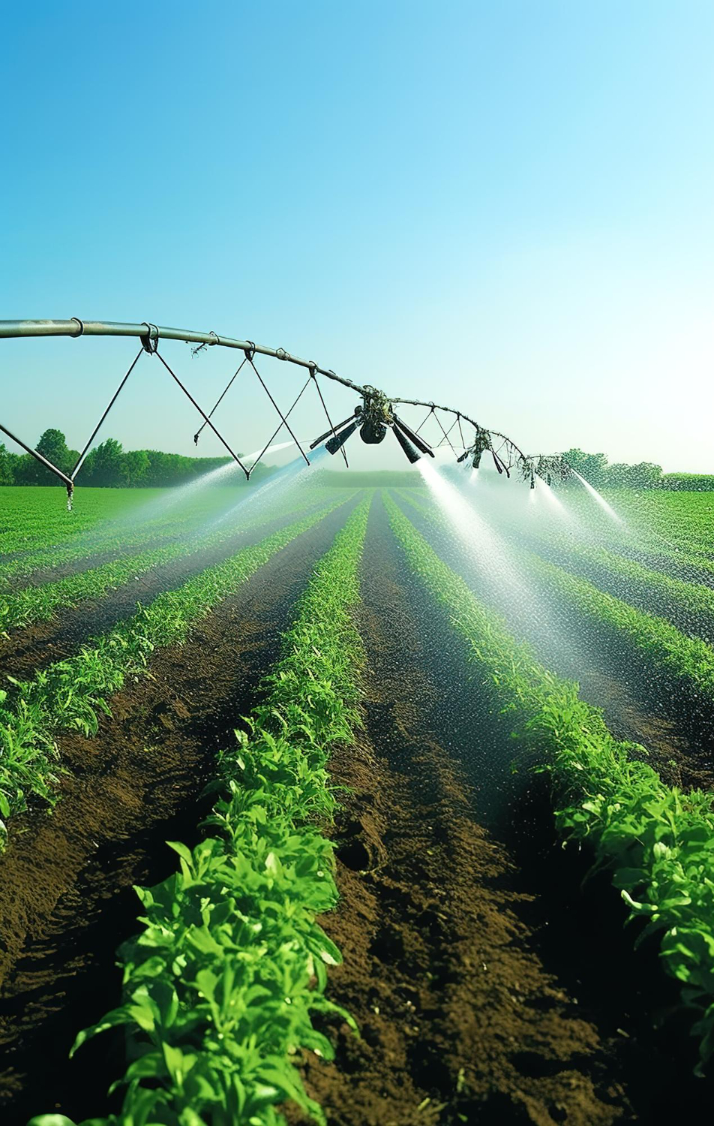
01. Sensor Integration
Automated Irrigation Systems
02. Efficient Water Use
Automated irrigation systems use technology to optimize water usage in agriculture, delivering the right amount of water to crops at the right time. These systems rely on various sensors and IoT devices to monitor soil moisture, weather conditions, and plant water requirements. Here’s a breakdown of how they function and their benefits:
03. Remote Control and Monitoring
04. Enhanced Crop Health and Yields
05. Cost Savings

Slide 7
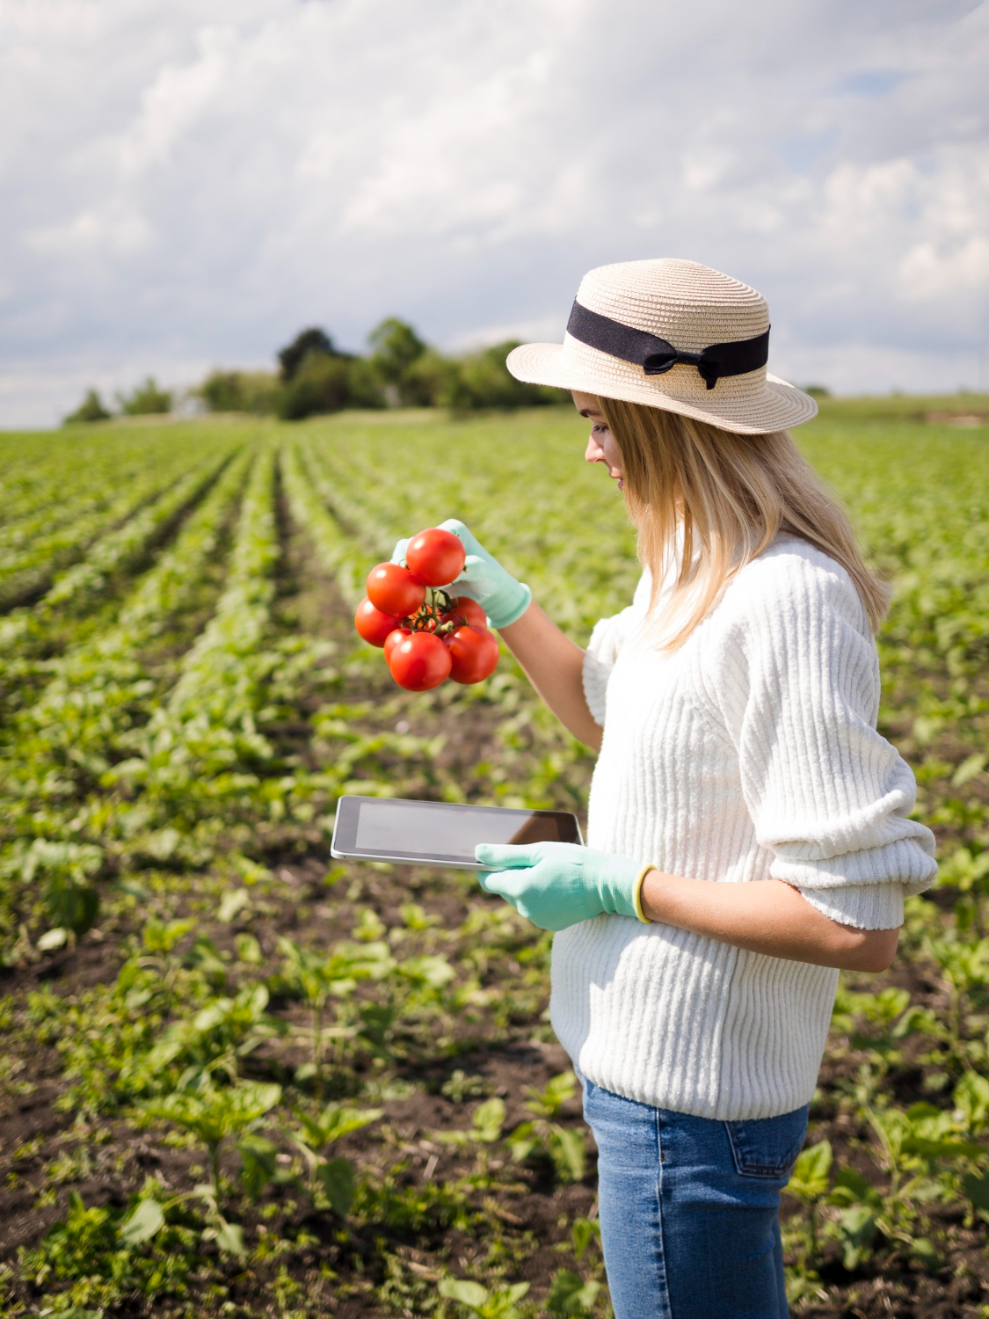
Crop Monitoring And Management
Crop monitoring and management through IoT and advanced technologies enable farmers to maintain crop health and optimize yield. Here’s how these systems work and their benefits:
Real-time Monitoring
Field sensors gather soil moisture, temperature, and crop health data for immediate response.
Disease and Pest Detection
Drones and imaging tech detect early signs of pests and diseases for timely intervention.

Slide 8





Supply Chain Optimization
Supply chain optimization in agriculture involves leveraging technology to enhance the efficiency and transparency of the path from farm to table. This process ensures that agricultural products are produced, harvested, processed, and delivered to consumers in the most effective manner.
Traceability
Inventory Management
Demand Forecasting
Transportation Logistics
Collaboration Platforms

Slide 9
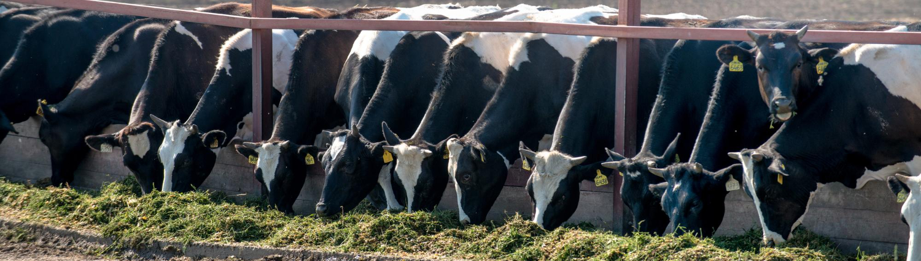
Livestock Monitoring
IoT enhances livestock monitoring by tracking health, location, and behavior in real-time, enabling early illness detection, improved breeding, and optimized feeding for better farm management.
Health Monitoring Sensors
GPS Trackers
Automated Feeding Systems
Behavioral Analysis

Slide 10
Challenges And Solutions
Challenges
Challenges
High Initial Costs
Cost-effective Technology
Connectivity Issues
Enhanced Connectivity Solutions
Data Management and Security
Advanced Data Analytics
Technical Skills Gap
Training and Education
Integration with Existing Systems
Customizable IoT Solutions

Slide 11

Conclusion
IoT in agriculture enhances efficiency, productivity, and sustainability, revolutionizing farming with real-time data, precise management, and innovative solutions to challenges in modern agriculture.

Slide 12
Icons

Slide 13
Icons

Slide 14
How To Edit Shapes
You can add and edit some shapes to your presentation to present your data in a visual way.
Choose your favourite infographic and insert it in your presentation using Ctrl C + Ctrl V or Cmd C + Cmd V in Mac.
Select one of the parts and ungroup it by right-clicking and choosing “Ungroup”.
Change the color by clicking on the paint bucket.
Then resize the element by clicking and dragging one of the square-shaped points of its bounding box (the cursor should look like a double-headed arrow). Remember to hold Shift while dragging to keep the proportions.
Group the elements again by selecting them, right-clicking and choosing “Group”.
Repeat the steps above with the other parts and when you’re done editing, copy the end result and paste it into your presentation.
Remember to choose the “Keep source formatting” option so that it keeps the design. For more info, please visit Slideegg (Tips & Tricks).

Slide 15
Terms Of Use (Free Users)
If you are a free subscriber, you should credit SlideEgg by keeping the “Thank You” slide.
Kindly refer to the following slide for the Terms of Use for premium users.
You can:
Customize or edit this template
Use this template for both business and personal endeavors.
You can not:
Sell, rent, or second-license SlideEgg content or its altered version. Promulgate, unless explicitly permitted, SlideEgg content, by SlideEgg.
Incorporate SlideEgg content in any database or file online or offline.
Obtain SlideEgg content’s copyright.
Kindly refer to our Tutorial page or FAQ for advanced slide modification guidelines.

Slide 16
Terms Of Use (Premium Users)
Being a premium subscriber, you have the privilege of using this PPT template
without giving attribution to SlideEgg or keeping the “Thank You” slide.
You can:
Customize or edit this template.
Use this template for both business and personal endeavors.
Circulate or share the editable format of this template with anyone you want.
You can not:
Sell, rent or second-license SlideEgg content or the altered version of it. Promulgate or include the templates in any other services database
that performs as distribution or resale platform, unless explicitly permitted, by SlideEgg.
Incorporate the elements used in SlideEgg templates separately.
Obtain SlideEgg copyright for the elements used in this template as a logo or trademark.
Kindly refer to our Tutorial page or FAQ for advanced slide modification guidelines.

Slide 17






Thank You!
We respect your valuable time with SlideEgg!
If you have any questions, please reach us
Do you have a design request, please visit our Deckez site.
CREDIT: SlideEgg created this PowerPoint template.
Let this slide be kept for attribution.
www.slideegg.com

